Slide 1
Root2AI Project
Model Result Report

Slide 2
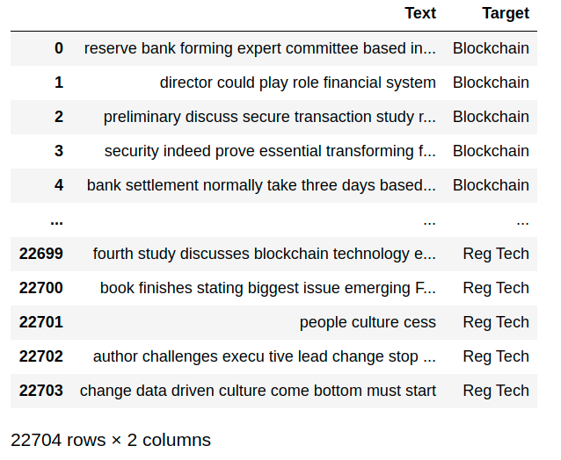
Preliminary Analysis of the Dataset
The given dateset consisted of two columns namely 'Text' and 'Target'. The 'Target' column contained different categories of companies, where as the 'Text' column contained text relevant to the category of the companies.

Slide 3
Approach:
The problem appears to be classification problem (NLP) that will require the following steps to solve:
Exploratory Text Analysis
Text Cleaning and preprocessing
Text Vectorization
Running Different ML Models and their accuracy comparison

Slide 4
Data
Visualization
After dropping the NaN values and resetting the index values of the dataset, the count of different categories of companies was visualised.

Slide 5
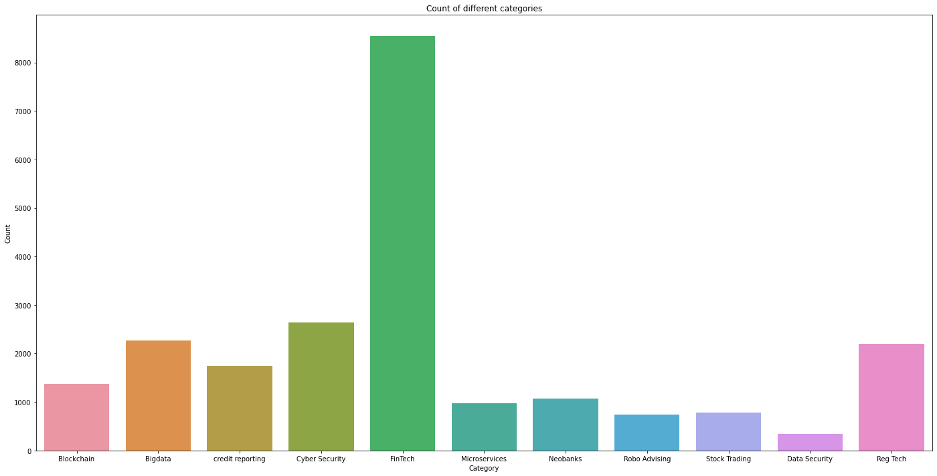

Slide 6
Preprocessing
The unique categories in the column target were found
These were then mapped to a numeric value to make our work easier.

Slide 7
Text Cleaning
Special characters from the 'Text' column were removed
The entire text was converted into lower case
The description of the words were tokenized.
Stopwords were removed.
The words were stemmed.
A corpus was created in the end containing the processes words.

Slide 8
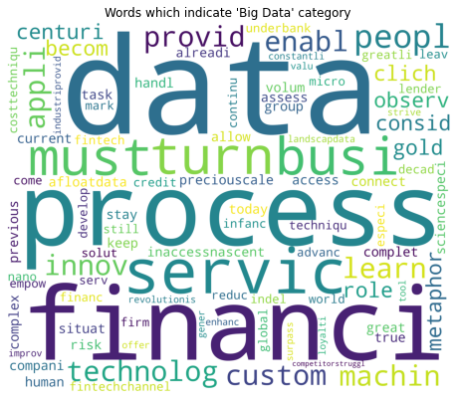
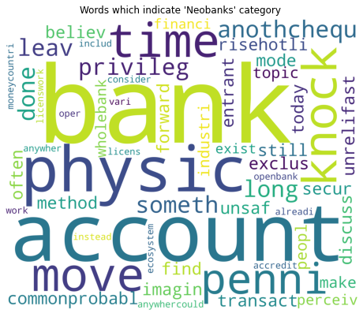
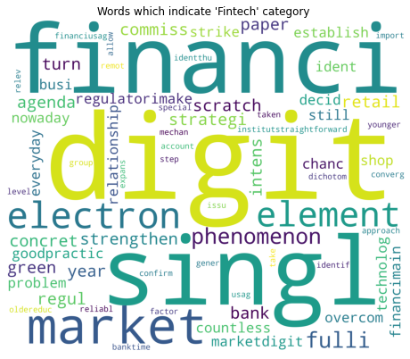
From the corpus wordclouds of different categories were formed
Wordcloud of 'Big Data' Category
Wordcloud of 'Neobank' Category
Wordcloud of 'Fintech' Category
Wordclouds represent how frequently some key words are used in relation to certain categories. The bigger the word in size, the more pertinent it is to the category.

Slide 9

Vectorization
The text was vectorized using Bag of Words method
TF-IDF was also used, but later on inspection it was found to lower the accuracy of the model and hence was commented out.

Slide 10
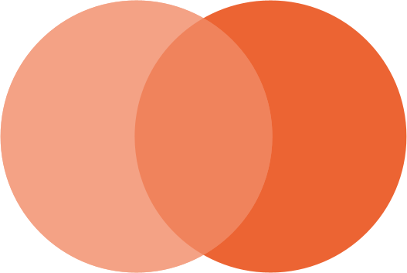
Model Building
The text was vectorized and and then split into training and test sets.
It was then fitted using different ML algorithms.

Slide 11
Algorithms and their accuracy
Naive Bayes
Random Forrest
Linear SVC
Accuracy = 65.17
Accuracy = 61.90
Accuracy = 62.05

Slide 12
Conclusion
TF-IDF
Naive Bayes
TF_IDF is lowering the accuracy of the model.
Naive Bayes is the preferred algorithm choice as it is the fastest and the most accurate.
Hyperparameter Tuning
Other ML algorithms
The accuracy can further be improved by hyper-parameter tuning.
The model can be trained on other ML algorithms that might be more accurate.

